Slide 1
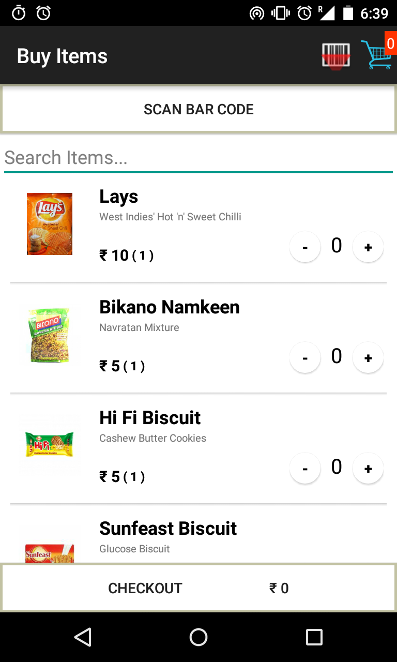
Project Name – ShopAssist ( FinTech )
Buyer
Freedom from carrying trolleys while shopping
No need to wait at long checkout queues
Track order history of their offline shopping
Online payment and home delivery options
Seller
Only keep display items in shelf for customers. So re-stocking is required only in warehouse without affecting customers shopping experience.
Less space required for Checkout counters as customers don't need to form queue, they only need to come to checkout counter when their cart is ready to be collected.
With online payment, customers tend to over-spend compared to customers paying via cash. Thus more profit for seller.

